Slide 1
Education and income level Is there a relationship?
Kayla Thompson

Slide 2
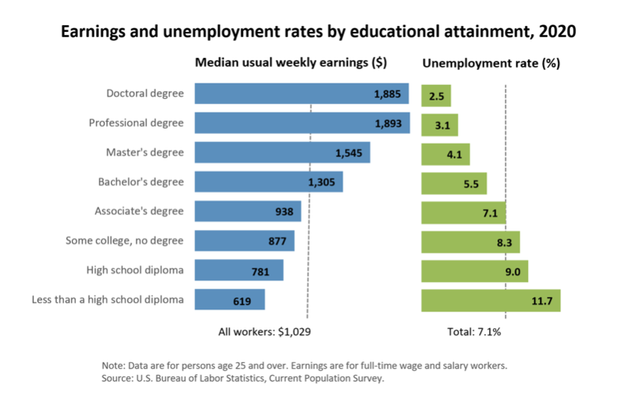
What does the Government say?

Slide 3
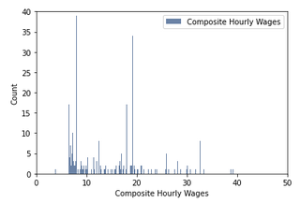
Methods and results

Slide 4
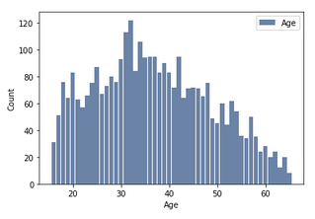
Methods and Results

Slide 5
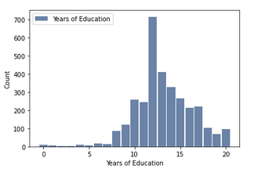
Methods and results

Slide 6
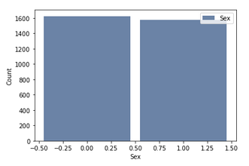
Methods and results

Slide 7
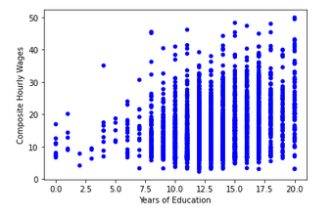
Methods and results

Slide 8
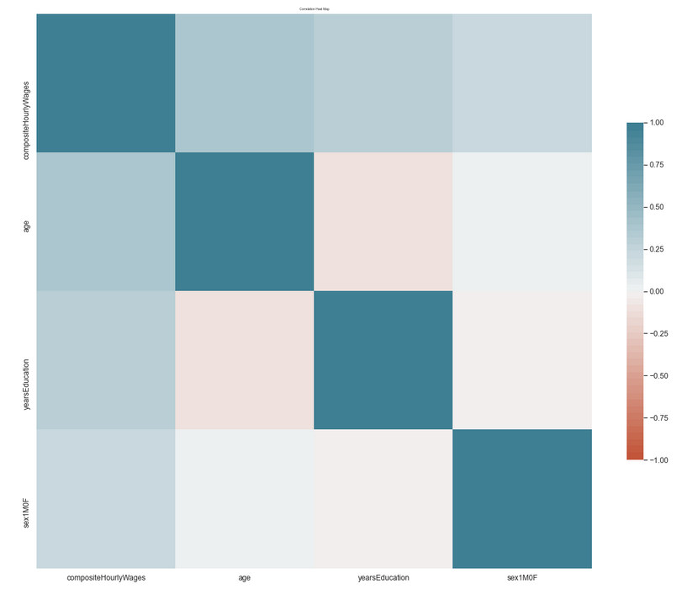
Methods and results

Slide 9
Linear Regression
RMSE for Train Data : 6.47
RMSE for Test Data: 6.49
Variance 0.0249

Slide 10
Random Forest
RMSE: 7.07

